Slide 1



Employee savings just because of where you work.

Slide 2

Save on your next Uber ride because of where you work!
NEW Offer!
Get up to
20/mo.
$
in credits
when you switch to Sprint.
2 Uber credits of up to $10 each/mo. for 12 mos. Req. new acct. active. on Unlimited Basic, Plus, or Premium and validation at sprint.com/verify.

Slide 3


Now get these three exclusive offers through the Sprint Works Program.
Register and verify at sprint.com/save
60
$
/year
Save every month
on select Unlimited plans
with your $5/mo. SWP discount on line 1.
20
Switch to Sprint and receive a
$100 Prepaid Mastercard®
per line up to $200.
Req. new acct. activ. with 1 ported line on Unlimited Basic
and validation at sprint.com/verify.
$
NEW Offer!
/mo.
in credits
when you switch to Sprint.
See final slide for details.

Slide 4

your first year over AT&T
Switch to Sprint
Save
$1,400
Compared to AT&T Unlimited & More for 5 lines, features differ and with SWP Prepaid Card savings.
See final slide for details.

Slide 5





Great value and savings with Sprint
Extras included with eligible Unlimited plans
Offers helping your team choose Sprint
with eligible Sprint Unlimited plans
Clean Slate℠ – Switch to Sprint and get up to $650/line to cover your switching fees.
Visit sprint.com/joinsprint.
Up to $650 (less required phone trade-in credit provided) via Prepaid Mastercard® after online registration and new phone activation. Amount based on early termination fee charged or remaining phone balance.
All your TV in one place with Hulu.
nearly $96/yr. value Reg. $5.99/mo.
with Unlimited Plus plan
Music streaming with TIDAL.
nearly $120/yr. value Reg. $9.99/mo.
Sprint Referral Rewards – up to $500/year.
Refer your friends and family and each receives $50. Visit sprint.com/referral.
Via Prepaid Mastercard® Requires activation of new smartphone on new account
Lookout Premium Plus for comprehensive security and identity theft protection.
nearly $120/yr. value Reg. $9.99/mo.
with Unlimited Premium plan
AutoPay saves $60/year for every line.
More lines = more savings.
Save $5/mo./line on select plans when you sign up for AutoPay.
HiFi music streaming with TIDAL.
nearly $240/yr. value Reg. $19.99/mo.
Get the best of shopping and entertainment. $119/yr. value
Reg. $12.99/mo.
Get our 100% Total Satisfaction Guarantee and see why Sprint is the right choice.
Applies to new lines of service. See details on final slide.
With AutoPay. Reqs. new account. Data deprioritization during congestion. 1 Hulu ad-supported plan per eligible Sprint acct. Unlimited Basic: Music up to 500 Kbps, gaming streams up to 2 Mbps. MHS reduced to 3G speeds after 500MB/mo. Unlimited Plus: Music up to 1.5 Mbps, gaming streams up to 8 Mbps. Includes TIDAL Premium. MHS reduced to 3G speeds after 50GB/mo. Select content in HD. HD content varies by device & connection. Unlimited Premium: Includes TIDAL High-Fidelity. MHS reduced to 3G speeds after 100GB/mo. Select content in HD. HD content varies by device & connection. Other mo. charges apply.** See final slide for details.

Slide 6
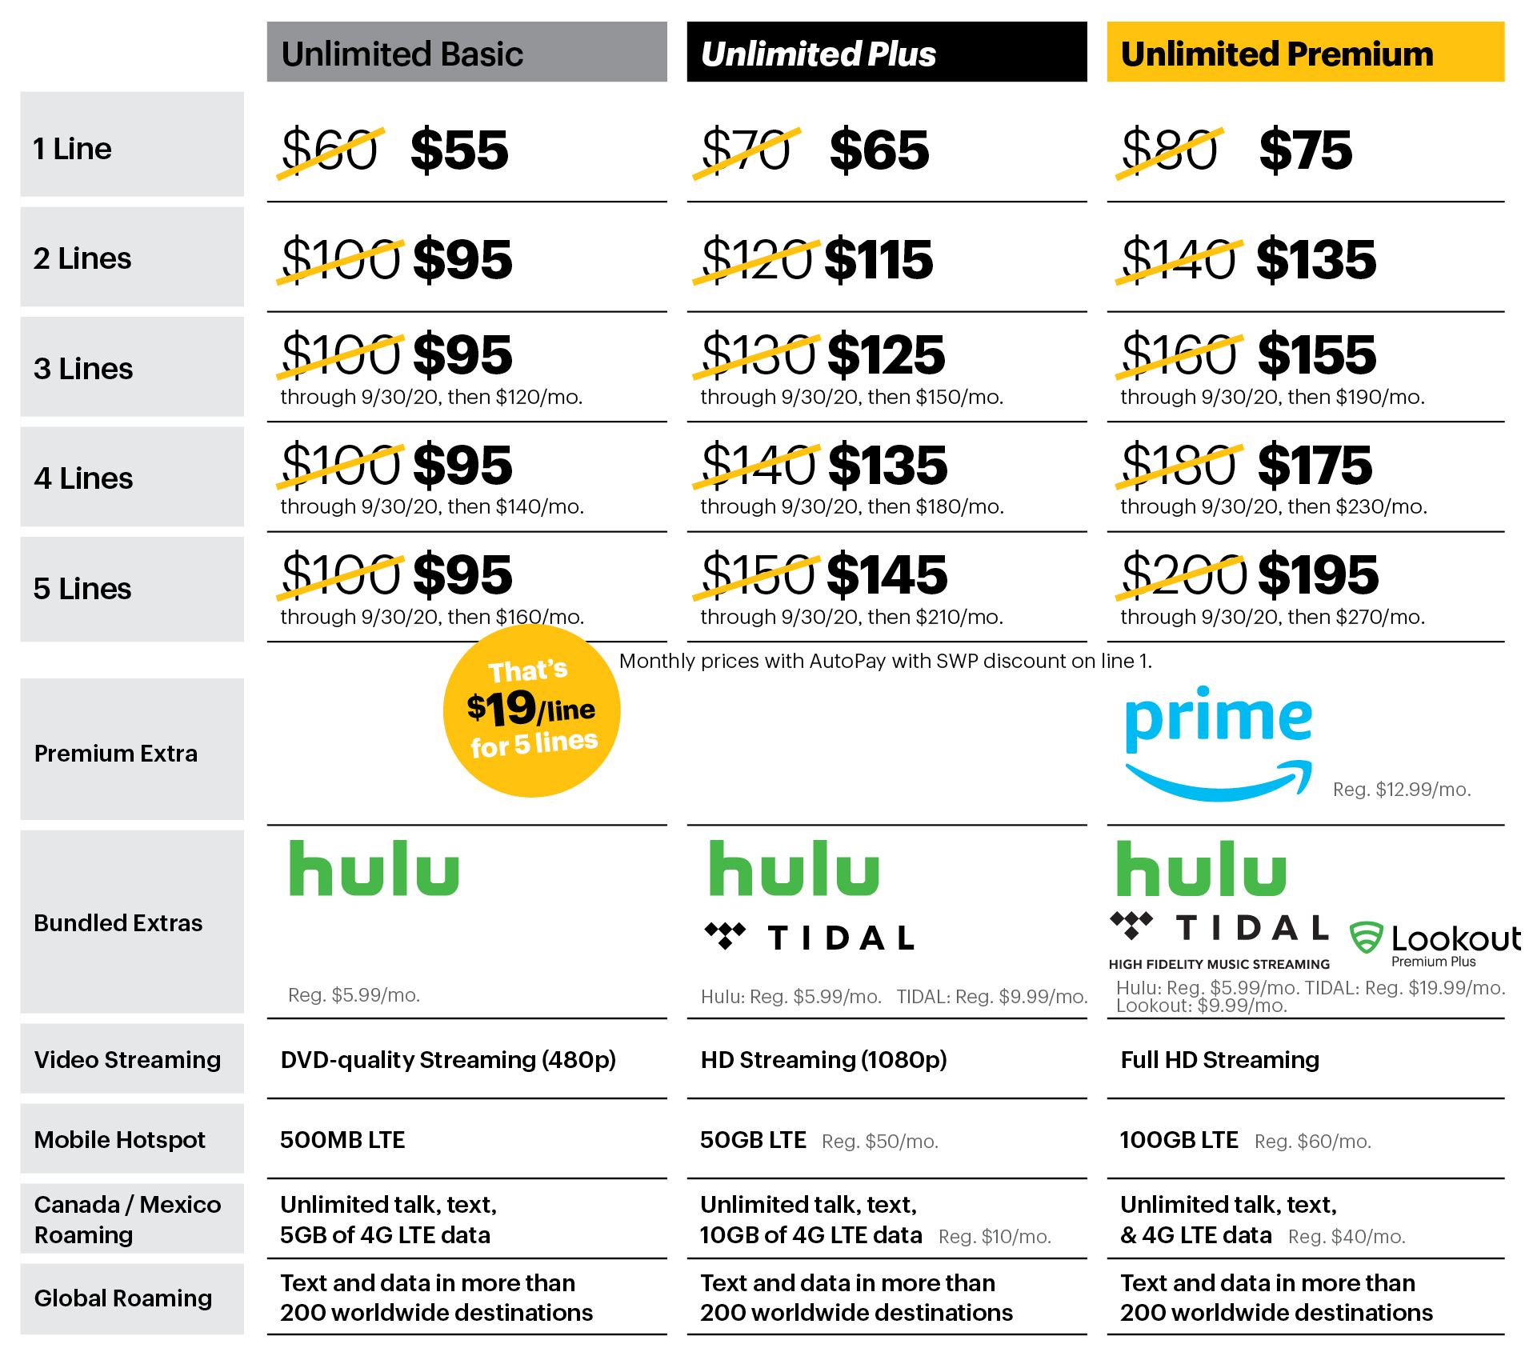
See how our Unlimited plans stack up!
Bring, buy or lease your phone, Sprint makes it easy to switch!
With AutoPay. Reqs. new account. Data deprioritization during congestion. 1 Hulu ad-supported plan per eligible Sprint acct. Unlimited Basic: Music up to 500 Kbps, gaming streams up to 2 Mbps. MHS reduced to 3G speeds after 500MB/mo. Unlimited Plus: Music up to 1.5 Mbps, gaming streams up to 8 Mbps. Includes TIDAL Premium. MHS reduced to 3G speeds after 50GB/mo. Select content in HD. HD content varies by device & connection. Unlimited Premium: Includes TIDAL High-Fidelity. MHS reduced to 3G speeds after 100GB/mo. Select content in HD. HD content varies by device & connection. Other mo. charges apply.** See final slide for complete details.

Slide 7

Introducing My Sprint Rewards
1
Join the Marketplace – Get access to Sprint’s 30 million base customers with your own discounts and promotions.
2
My Sprint Rewards is our way of saying “thanks” to your team.
Sprint Rewards – Special deals and experiences from Sprint and exclusive perks from your favorite brands.
Sprint Marketplace – Save with hundreds of discounts and cash-back rewards on apparel, entertainment, travel and more.
Just download our free app to start getting these amazing rewards.

Slide 8
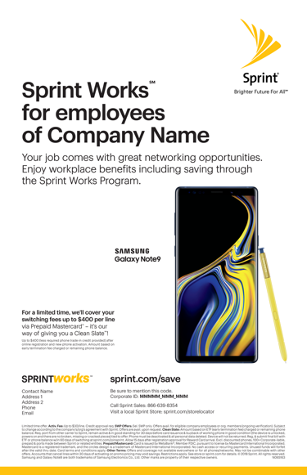
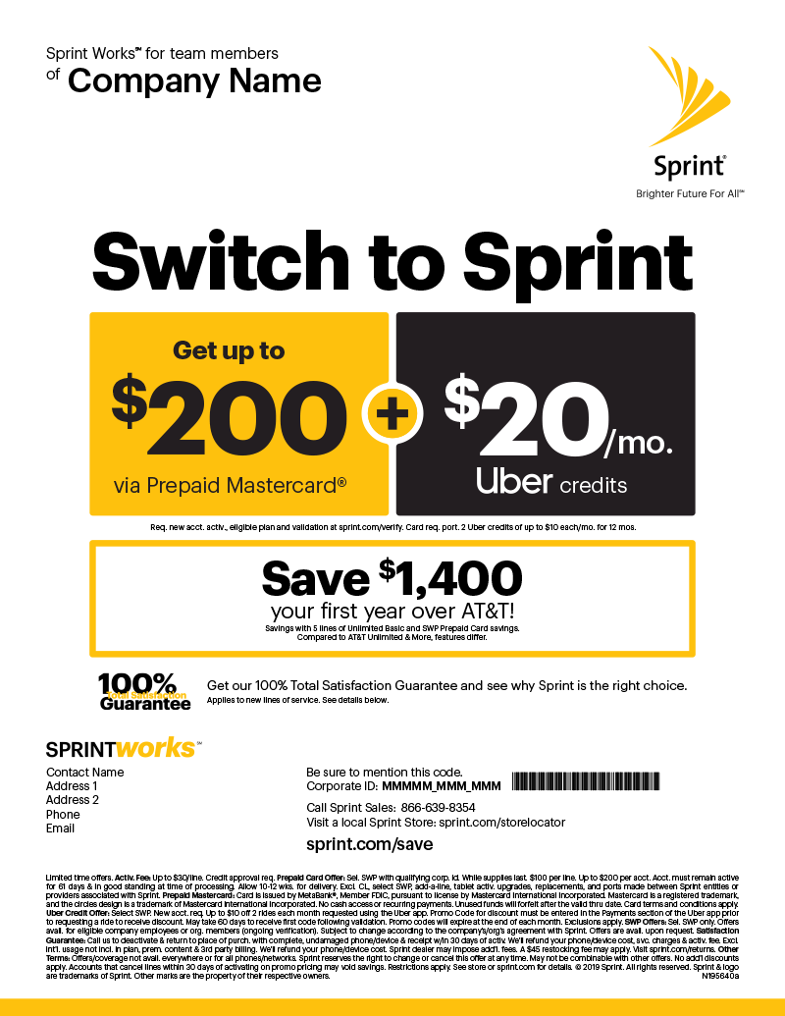
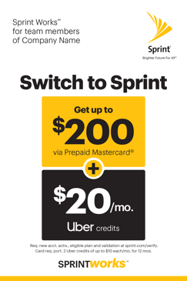
Sprint makes it easy to get the word out to your team!
We can provide a mix of collateral to get the word out about this valuable benefit, device offers and service plan savings.
Payroll stuffers
Wallet cards
Flyers
Table tents
Posters
Available offers subject to change

Slide 9
**Monthly charges exclude taxes & Sprint Surcharges [incl. USF charge of up to 24.4% (varies quarterly), up to $2.50 Admin. & 40¢ Reg. /line/mo. & fees by area (approx. 5–20%)]. Surcharges are not taxes. See sprint.com/taxesandfees.
Offers for a limited time only. Activ. Fee: Up to $30/line. Credit approval req.
Sprint Unlimited Basic, Plus & Premium Plan: Reqs eBill. Includes unlimited domestic calling, texting, Mobile Hotspot VPN & P2P & data as indicated above. Third-party content/downloads are add’l charge. Plan not avail. for tablets or MBB devices. Select Int’l svcs are included for phone lines. See sprint.com/globalroaming. Subsidized devices incur an add'l. $25/mo. charge. Amazon: Offer subject to change. Amazon Prime has a $12.99/month value. Amazon.com is not a sponsor of this promotion. AutoPay: $5/mo./line discount may not reflect on 1st bill. Hulu: Not available outside the U.S. Reqs qualifying Sprint service plan and registration of Hulu account from Sprint phone while on the Sprint network at hulu.com/sprint. Incl. access to one Hulu’s ad-supported plan per each eligible Sprint account (excl. other Hulu plans and add-ons) while eligible Sprint plan is active and in good standing. New or returning Hulu subscribers only. Valid also for existing Hulu-billed ad-supported plan subscribers (no third-party billed subscribers or premium add-on subscribers); no prorated credit or refund for current Hulu billing month, and remaining credit balances will be forfeited. Excludes CL accounts. Not redeemable or refundable for cash or gift subscriptions. Hulu may place account on inactivity hold based on Hulu usage. Cancel Hulu anytime. Subject to Hulu terms — see hulu.com/terms. Hulu offer made available by Sprint and may be modified or terminated at any time without notice. Quality of Service (QoS): Customers who use more than 50GB of data during a billing cycle will be deprioritized during times & places where the Sprint network is constrained. See sprint.com/networkmanagement for details. Usage Limitations: To improve data experience for the majority of users, throughput may be limited, varied or reduced on the network. Sprint may terminate service if off-network roaming usage in a month exceeds: (1) 800 min. or a majority of min.; or (2) 100MB or a majority of KB. Prohibited use rules apply — see sprint.com/termsandconditions.
Prepaid Card Offer: Sel. SWP with qualifying corp. id. While supplies last. $100 per line. Up to $200 per acct. Acct. must remain active for 61 days & in good standing at time of processing. Allow 10–12 wks. for delivery. Excl. CL, select SWP, add-a-line, tablet activ. upgrades, replacements, and ports made between Sprint entities or providers associated with Sprint. Sprint reserves the right to change or cancel this offer at any time.
SWP Discount: Sel. SWP only. $5/mo SWP discount on line 1 on Sprint Premium, Plus and Basic Plans. Avail. for eligible company employees or org. members (ongoing verification). Discount subj. to change according to the company’s/org.’s agmt. with Sprint & is avail. upon request. Not avail. with no credit check offers. Limit one SWP discount per acct. Acct. must remain in good standing to receive discount.
Clean Slate: Amount based on ETF (early termination fee) charged or remaining phone balance. Req. port from other carrier to Sprint, remain active & in good standing for 15 days before card issuance & buyback of working phone in good condition (the device is unlocked, powers on and there are no broken, missing or cracked pieces) tied to offer. Phone must be deactivated & all personal data deleted. Device will not be returned. Reg, & submit final bill with ETF or phone balance w/in 30 days of switching at sprint.com/joinsprint. Allow 3 business days after approval for virtual reward or 15 days for prepaid card. Excl. 100+ Corporate-liable, prepaid & ports made between Sprint or related entities.
Referral Offer: 1 reward per referee account. Req. at least 1 new-line on same day as new acct. activation on qual. plan. Excl. additional lines on same account, add a line, tablet & mobile broadband devices. Up to $500/yr. in referral rewards. Referrer’s reg at: www.sprint.com/referral & msg. sent prior to new acct. opening. Referrer’s existing acct. must be active for at least 24 hours prior to Referee’s new acct. opening. Both referrer & referee must remain active Sprint customer & be in good standing at time of fulfillment, up to 10 wk. after new account active. Customers on BYOD 1 Year Free are not eligible. Excl. CL purchases via subsidy and 100+, Enterprise & Public Sector/Gov., SWAC & ERC. Excl. National Retailer & Indirect channel employees. Customer will receive one $50 prepaid card.
Prepaid Card/Virtual Account: Issued by MetaBank®, Member FDIC, pursuant to license by Mastercard International Incorporated. Mastercard is a registered trademark, and the circles design is a trademark of Mastercard International Incorporated. No cash access or recurring payments. Card can be used where Debit Mastercard is accepted. Virtual Account can be used online where Debit Mastercard is accepted. Unused funds will forfeit after the valid thru date. Terms and conditions apply.
Satisfaction Guarantee: Call us to deactivate & return to place of purch. with complete, undamaged phone/device & receipt w/in 30 days of activ. We'll refund your phone/device cost, svc. charges & activ. fee. Excl. int'l. usage not incl. in plan, prem. content & 3rd party billing. We'll refund your phone/device cost. Sprint dealer may impose add'l. fees. A $45 restocking fee may apply. Visit sprint.com/returns.
Other Terms: Offers/coverage not avail. everywhere or for all phones/networks. May not be combinable with other offers. No rainchecks. No add’l discounts apply. Accounts that cancel lines within 30 days of activating on promo pricing may void savings. Included features/content may change or be discontinued at any time. Restrictions apply. See store or sprint.com for details. © 2019 Sprint. All rights reserved. All Amazon ®, TM & © are IP of Amazon.com, Inc. or its affiliates. Sprint & the logo are trademarks of Sprint.

